Slide 1
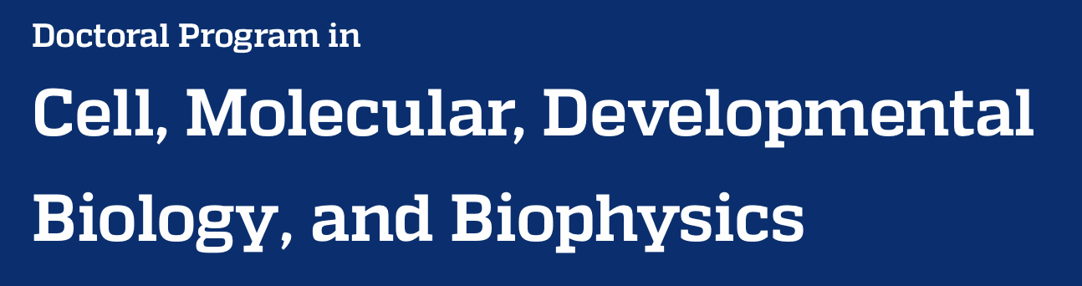




Quantitative Biology Bootcamp
Notes:
Title

Slide 2
Big Picture
Notes:
Section 1

Slide 3
30,000 ft Overview
You’re in the right Zoom
Spend next five days together
Gain comfort with computational tools like Unix and Python
Become conversant in bioinformatics projects and data analysis
Prepare for yearlong quantitative biology lab
Geared for biologists with zero computational experience
We’re here to help
Can only help if you ask for help

Slide 4
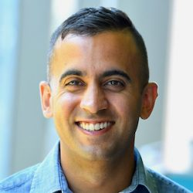
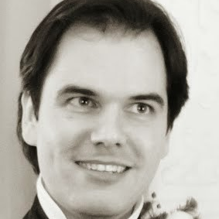
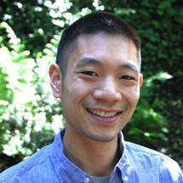
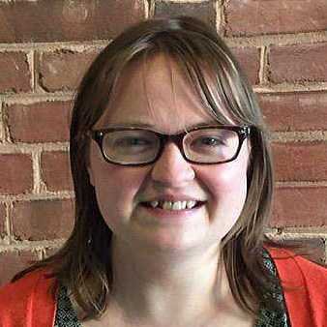
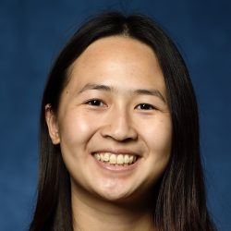
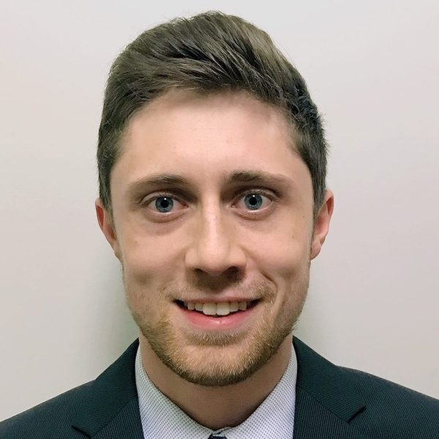
Introductions
Rajiv
Mike
Fred
Kate
Steph
Dylan

Slide 5
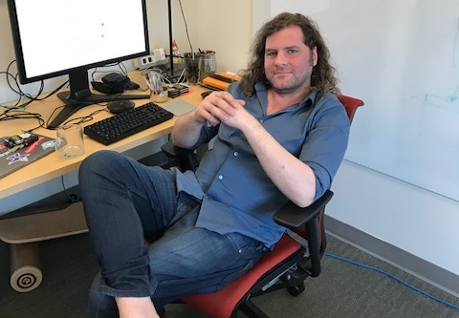
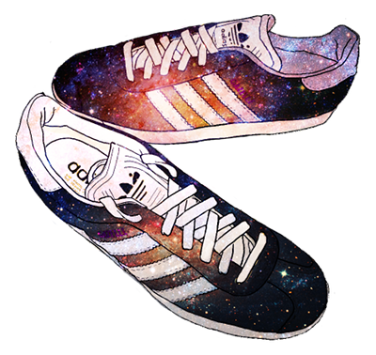
Design by Rebekka Paisner
James Taylor (1979-2020)
jxtx-memorial.github.io

Slide 6
What? Short Overview
Quantitative and computational methods are increasingly essential to all sub-disciplines of modern biological research. The goal of this intensive week-long “boot camp” is to empower students with the fundamental skills to apply these methods, as well as connect them to resources for further developing their knowledge and abilities.
The class starts at 10 am with formal instruction ending at 5 pm daily. The course demonstrates the importance of version control, documentation, testing, and other methods for enhancing reproducibility, reliability, and useability of software. This is achieved through live coding sessions and use of active learning exercises, where for the majority of the class, students perform data analysis to address biological questions and reinforce core bioinformatic concepts.

Slide 7
Why? Modern biology is data intensive
Large scale data acquisition has become easy,
e.g. high-throughput sequencing and imaging
Experiments are increasingly complex
Making sense of results often requires mining and making connections across multiple databases
Nearly all high-profile research involves some
quantitative methods

Slide 8
Idea
Experimental design
Experiment
Data collection
Raw Data
Data cleaning
Tidy Data
Data processing that
affects the results
Data analysis
Summarized data
The part that
might get published
Inference
Results
Data Pipeline, inspired by Leek and Peng, Nature 2015
Notes:
Data pipeline inspired by Leek and Peng, Nature 2015.

Slide 9
The methods section of a paper should provide sufficient detail to reproduce an experiment.
Notes:
While quantitative and computational methods are essential for modern biological research, are they being used well? In particular: how reproducible are these analyses?

Slide 10
The methods section of a paper should provide sufficient detail to reproduce an experiment.
For computational research, you can go a step further: provide the raw data and the code.
Notes:
While quantitative and computational methods are essential for modern biological research, are they being used well? In particular: how reproducible are these analyses?

Slide 11
The methods section of a paper should provide sufficient detail to reproduce an experiment.
For computational research, you can go a step further: provide the raw data and the code.
How has this worked in practice?
Notes:
While quantitative and computational methods are essential for modern biological research, are they being used well? In particular: how reproducible are these analyses?

Slide 12
Reproducibility Project: Cancer Biology
Independently replicating 50 “high-impact”
cancer studies from 2010-2012
osf.io/e81xl/wiki/home
Notes:
Enter the Reproducibility Project: Cancer Biology, a project that attempted to independently replicate 50 “high-impact”
cancer studies from 2010-2012.

Slide 13
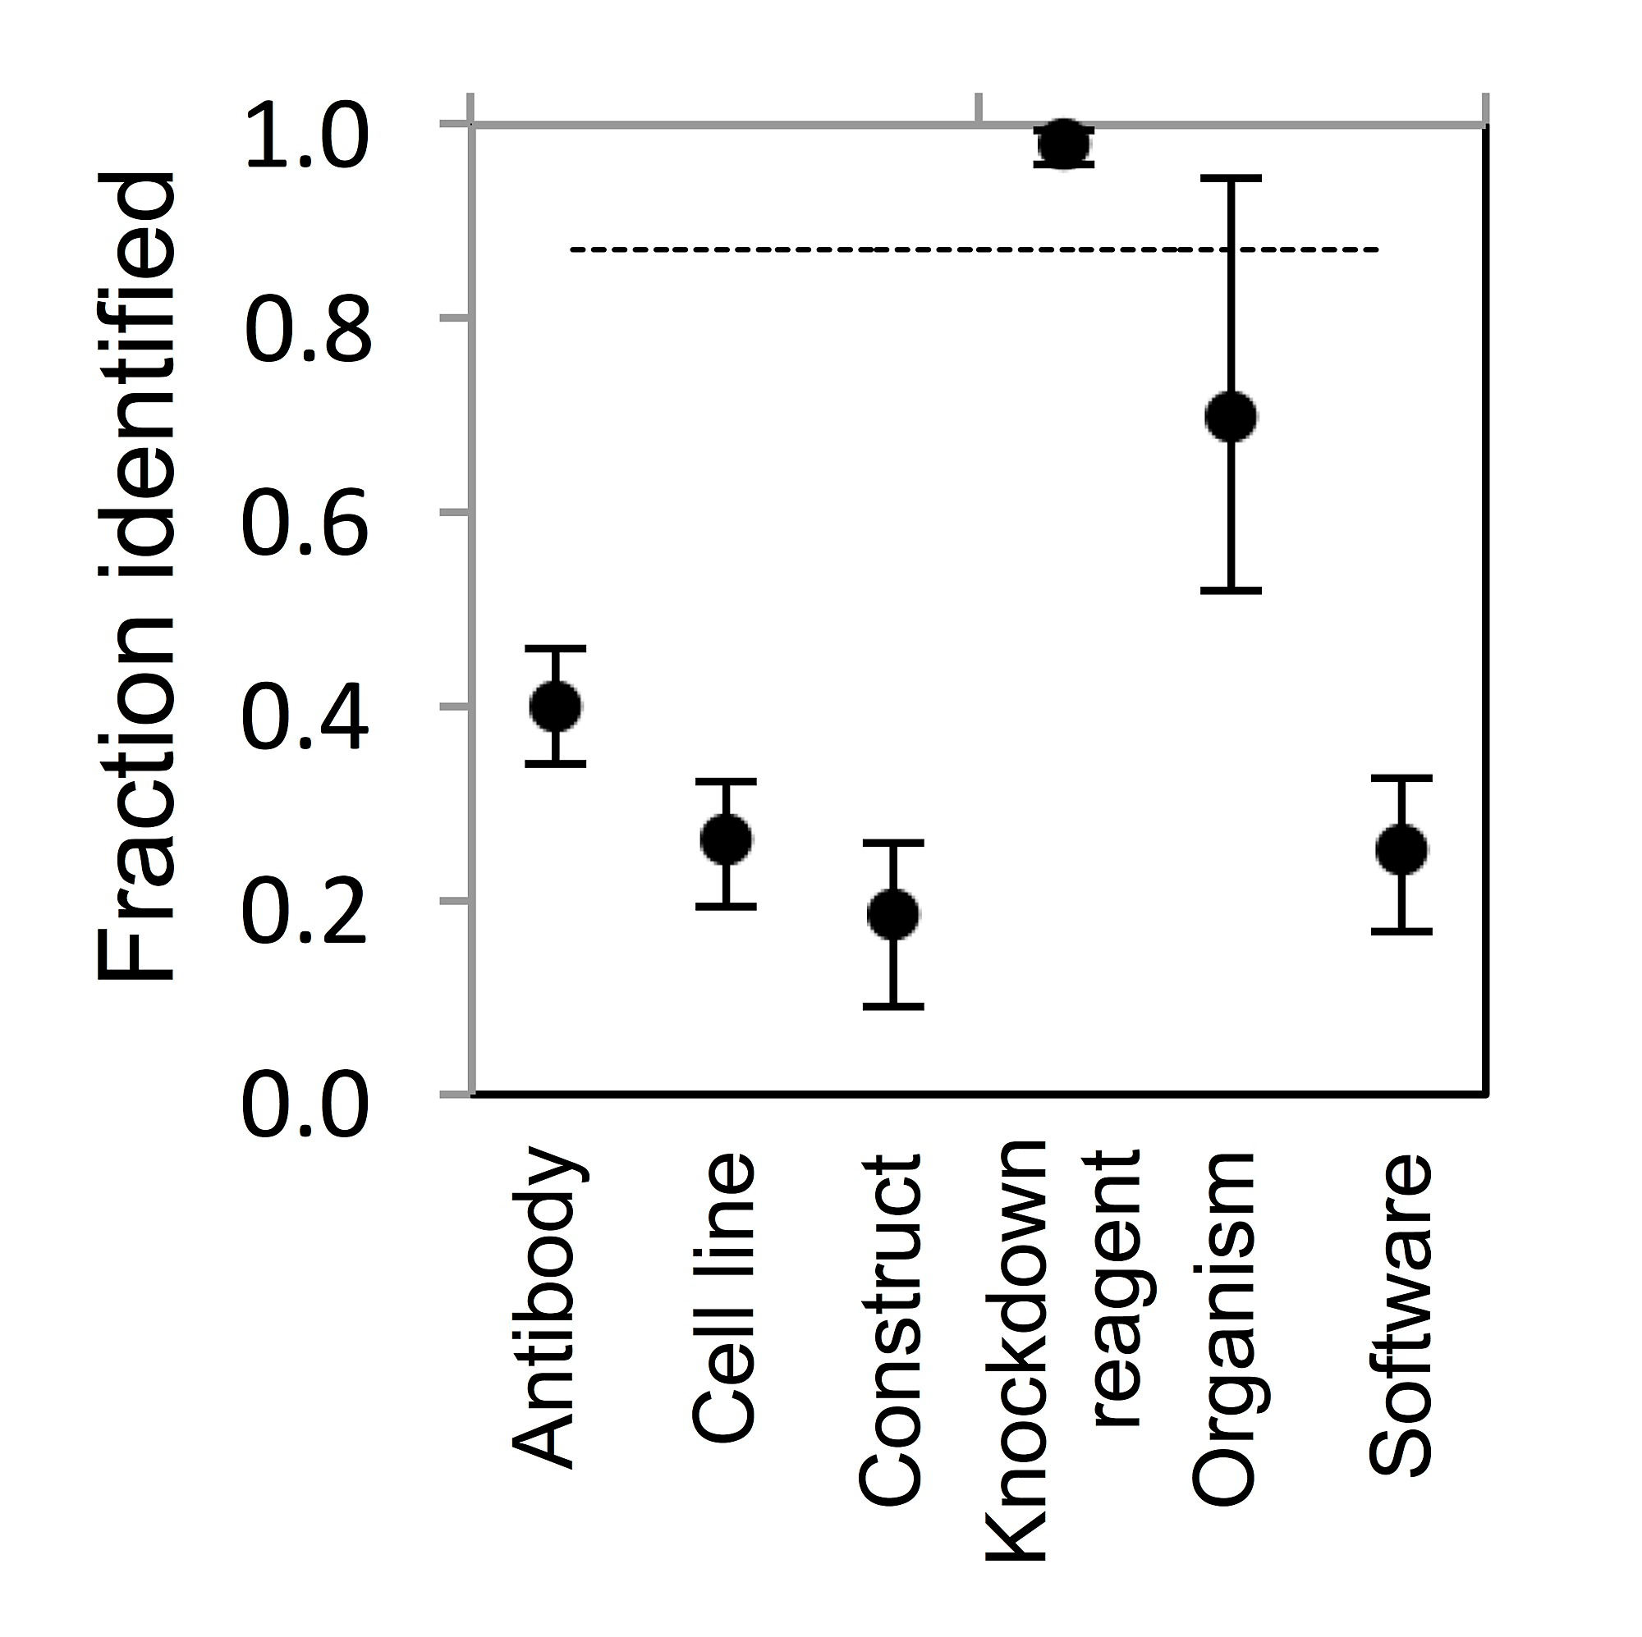
32/127 tools
6/41 papers
dx.doi.org/10.6084/m9.figshare.987130
Notes:
Only a quarter of the papers provided sufficient details about the software used.

Slide 14
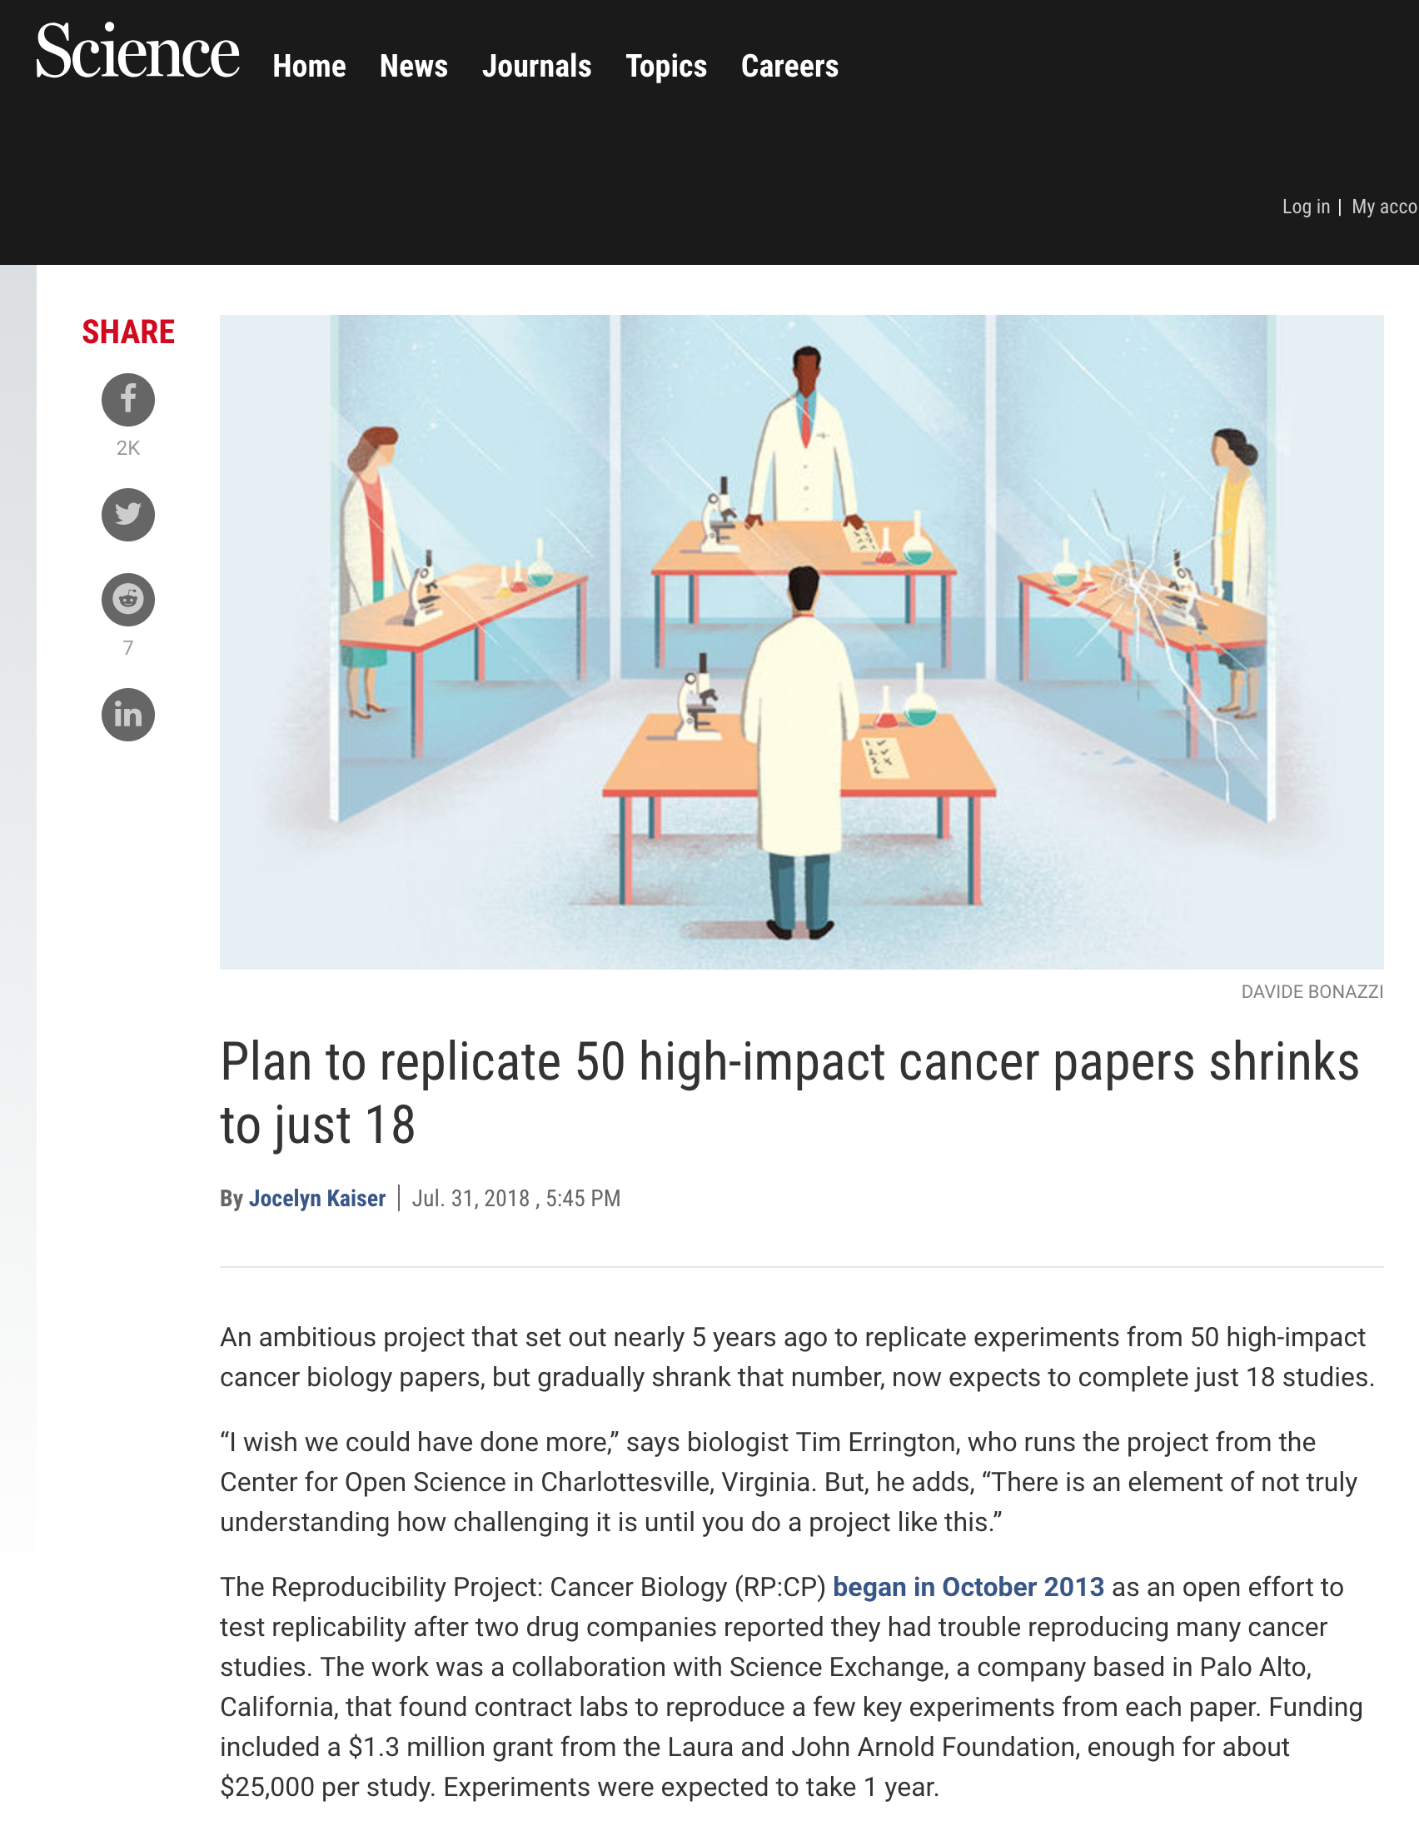
Notes:
The great difficulty to identify details forced the project to scale back from 50 to just 18.

Slide 15
Reproducibility Project: Cancer Biology
“The project has already published replication results for 10 of the 18 studies in the journal eLife. The bottom line is mixed: Five were mostly repeatable, three were inconclusive, and two studies were negative, but the original findings have been confirmed by other labs.”

Slide 16
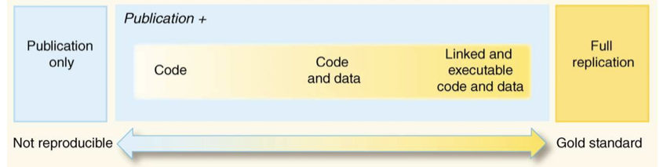
Spectrum of Reproducibility
doi:10.1126/science.1213847

Slide 17
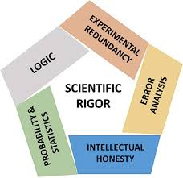
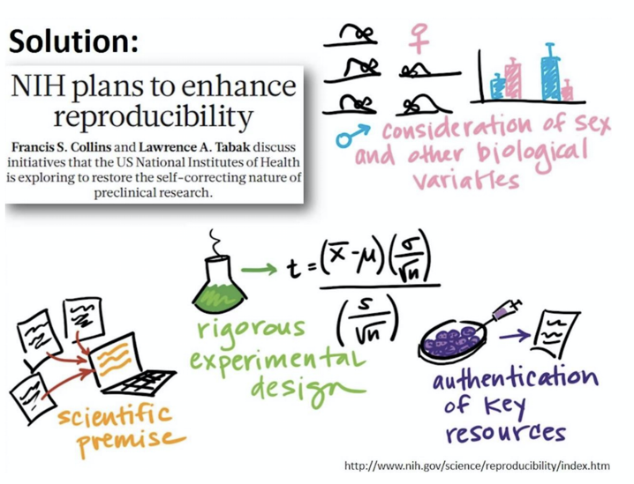

Slide 18
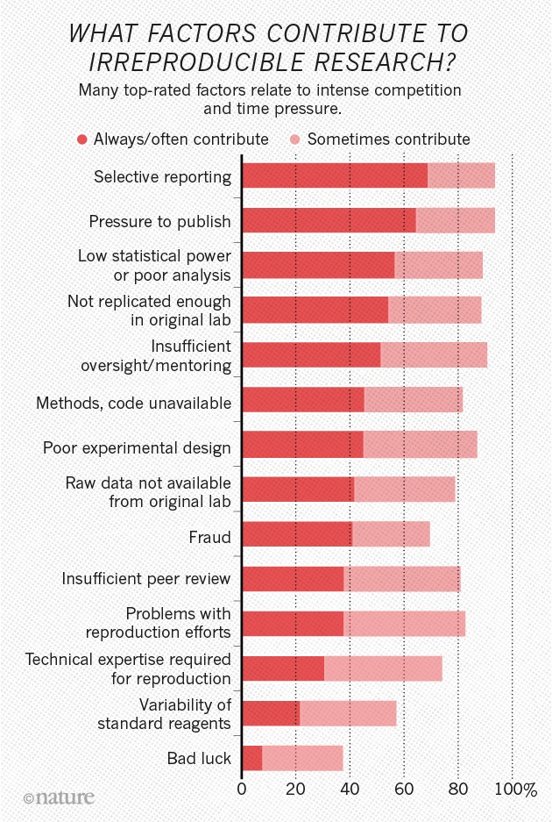
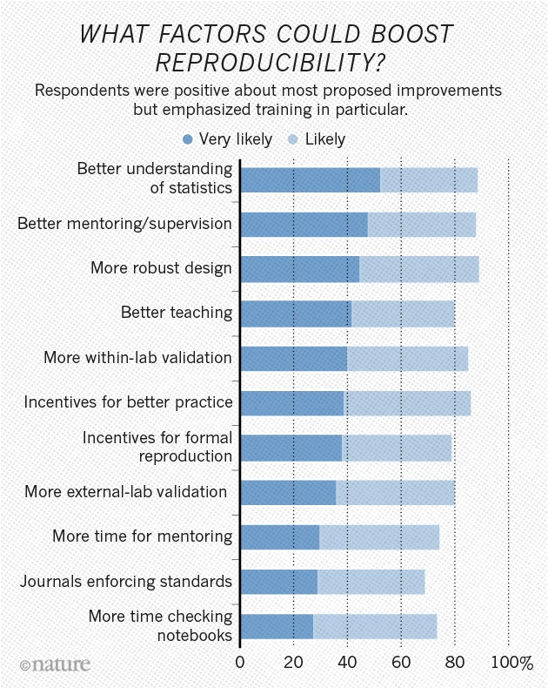
doi:10.1038/533452a

Slide 19
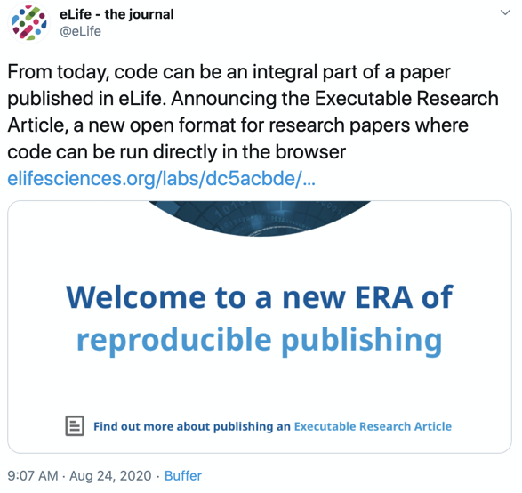
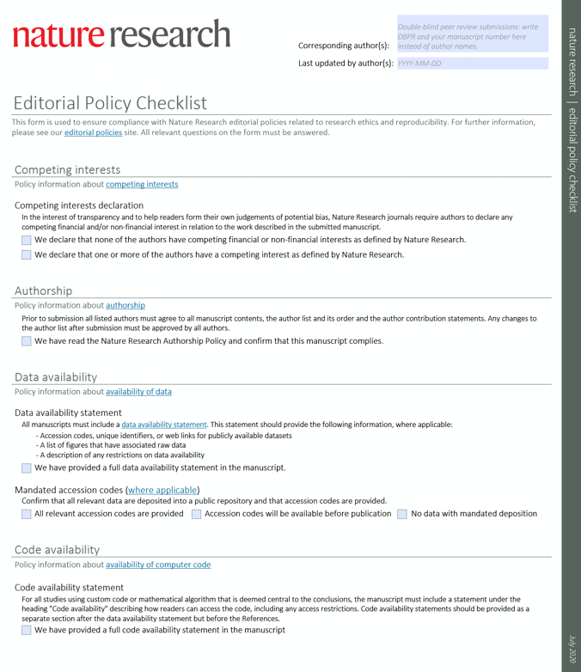
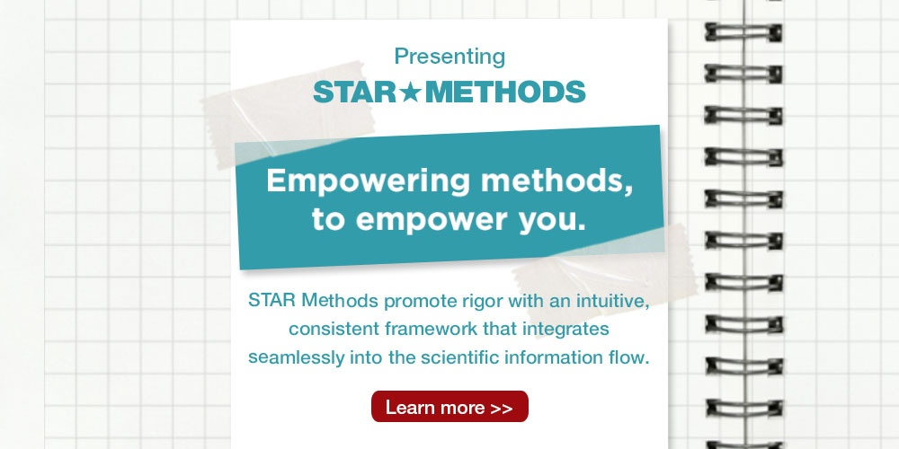

Slide 20
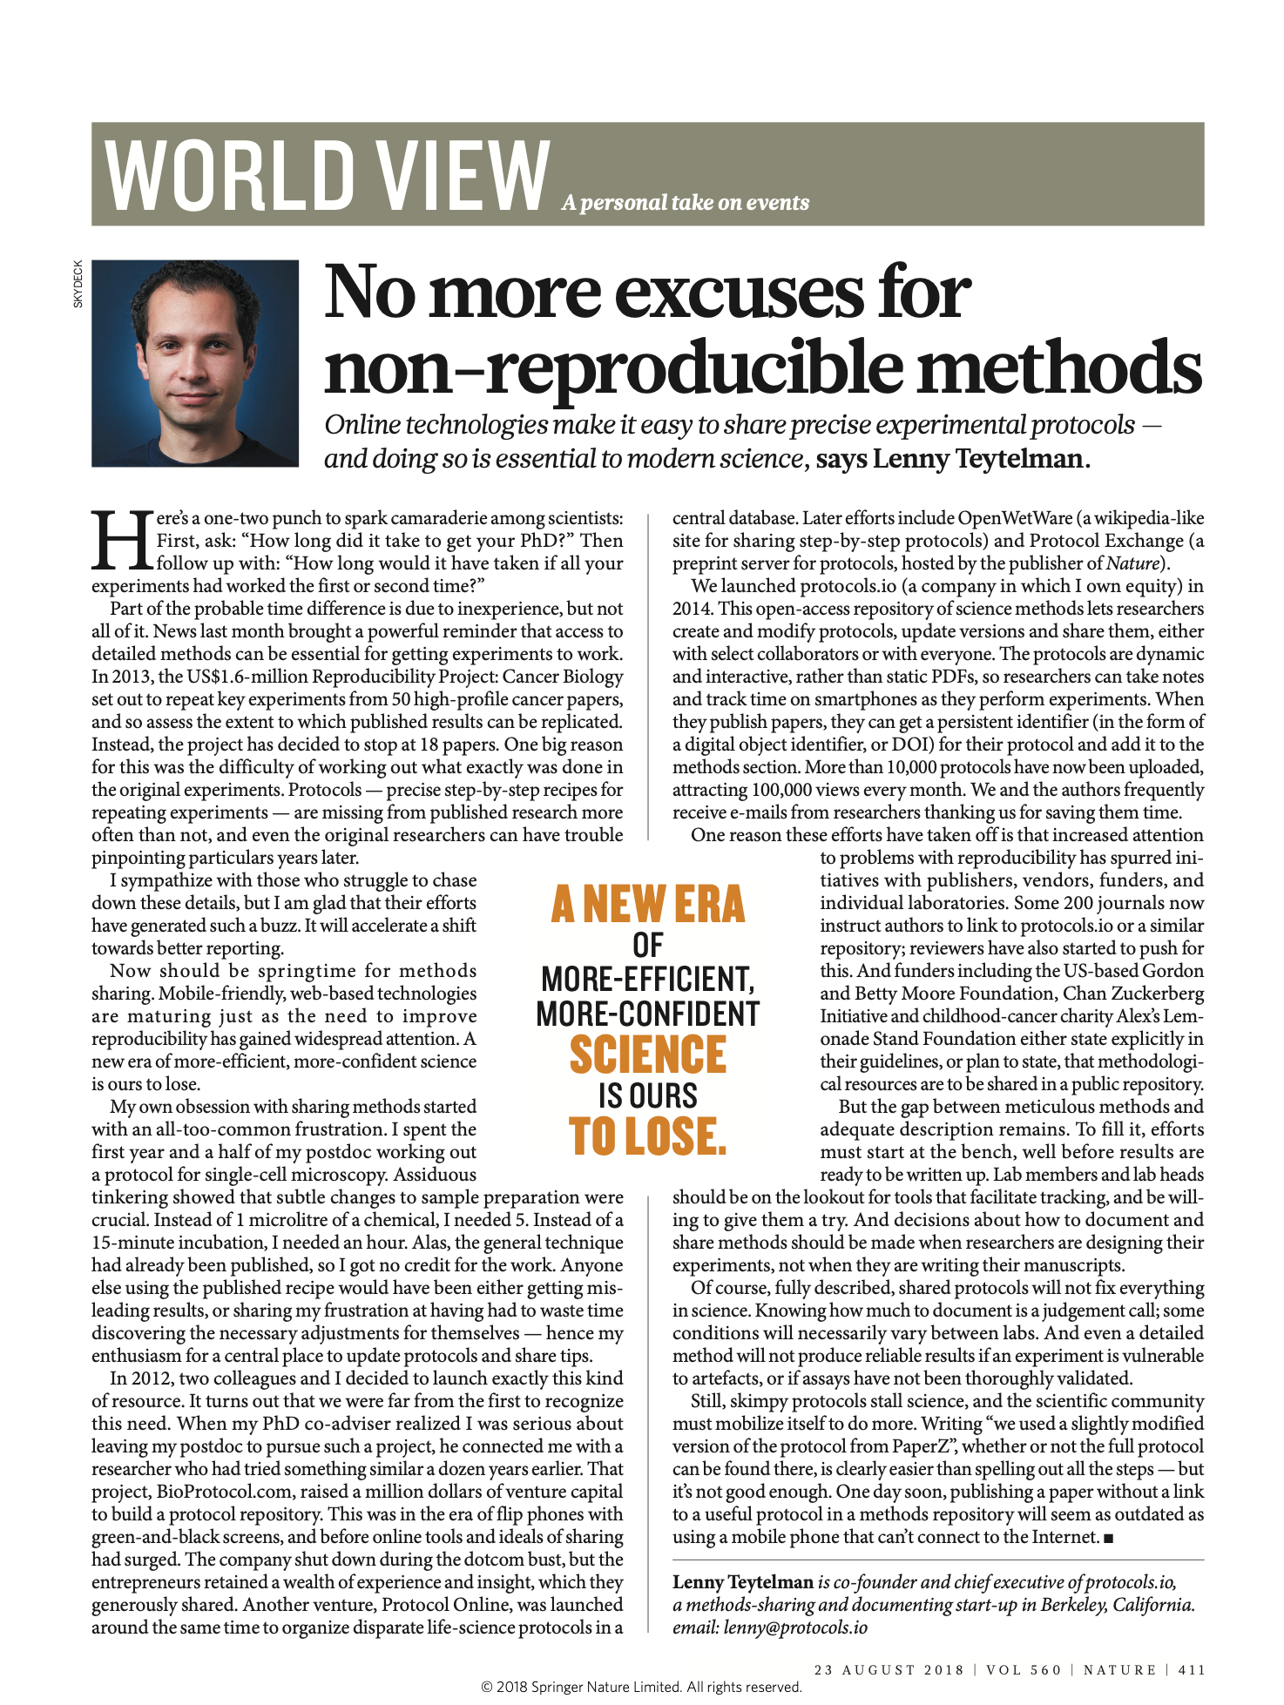













Slide 21
Our Goals
Become comfortable using and writing software
to work with large-scale biological data.
Be able to reuse and reproduce analyses.
Understand the importance of tools and
practices like version control and apply them.
Get some initial exposure to key data analysis
problems and be prepared to approach a wide variety
of data analysis problems throughout the coming year.

Slide 22
Learning Objectives
Develop comfort working within a UNIX environment and at the command line to build and run programs
Develop confidence using Python and its extended ecosystem of tools for bioinformatic data analysis and visualization
Develop knowledge of standard bioinformatic file formats and where they fit within the context of a project
Develop appreciation for and practice of concise and transparent presentation of data
Develop fluency in basic statistical tests, associated assumptions, and interpretation of their output
Develop good habits for ensuring reproducible research

Slide 23
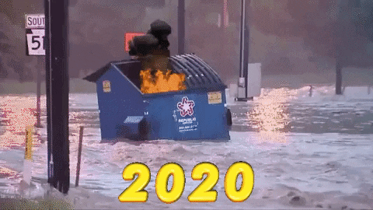
The Pandemic
We know that this is one of the least ideal situations in which to be starting your first year of grad school and taking an intensive week-long coding course. Our plan is to be as understanding as possible about grading, attendance, and any issues that come up. Please don’t hesitate to reach out to an instructor or TA if you are having issues, and we will do our best to accomodate you however we can.

Slide 24
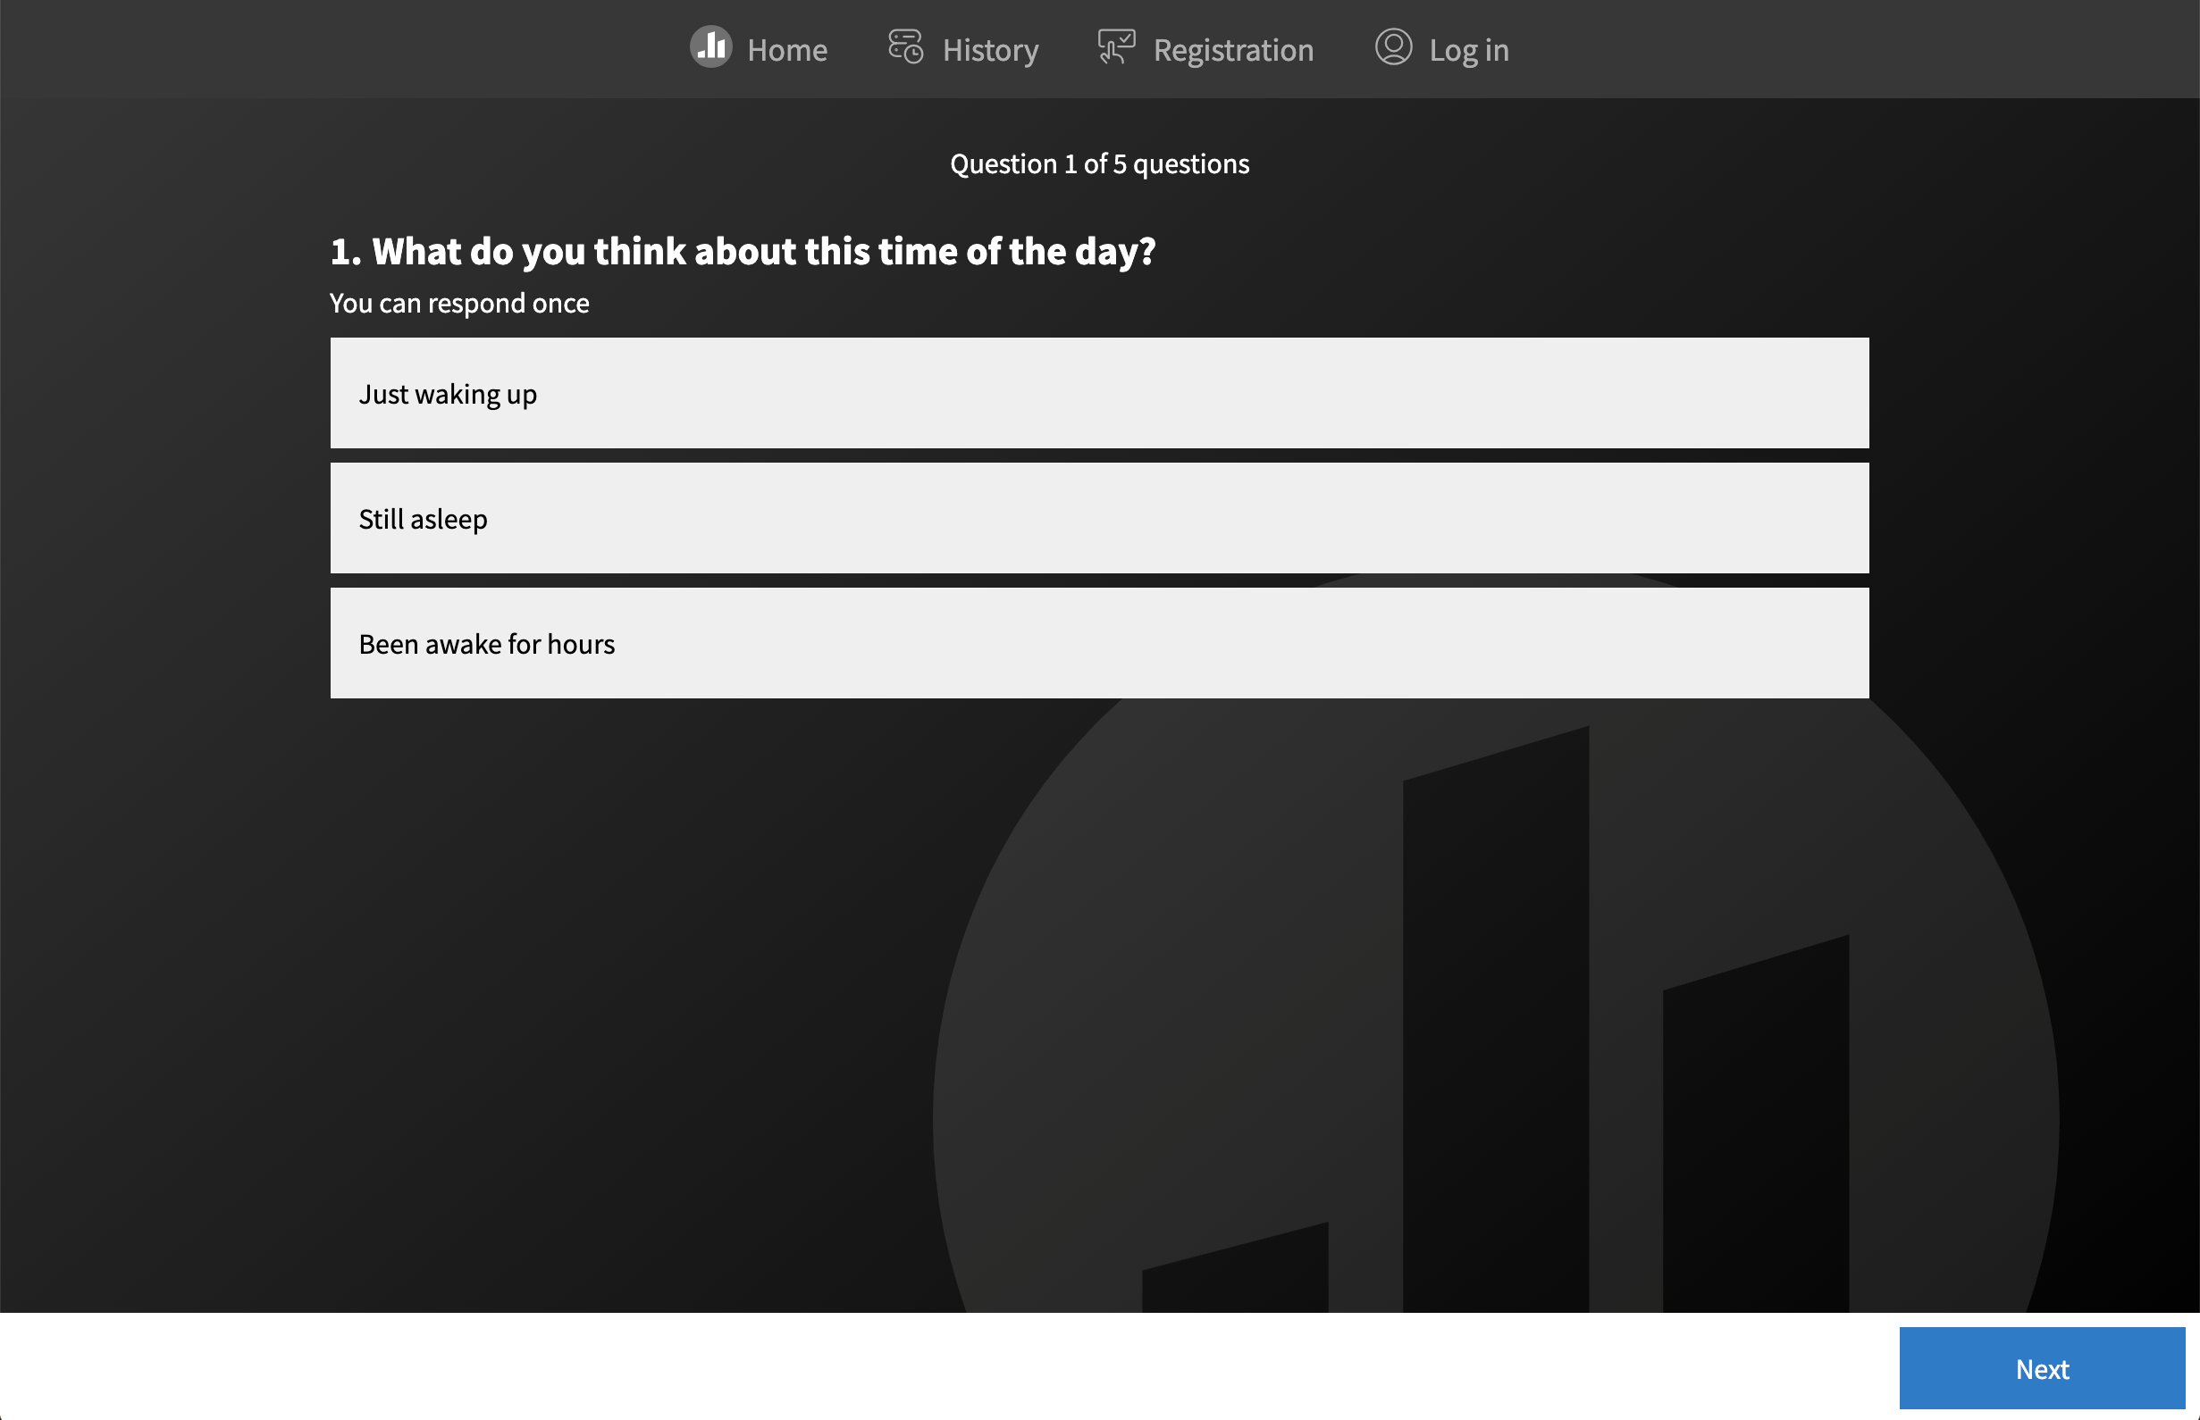
pollev.com/qbb2020ta1

Slide 25
Logistics
Notes:
Section 1

Slide 26
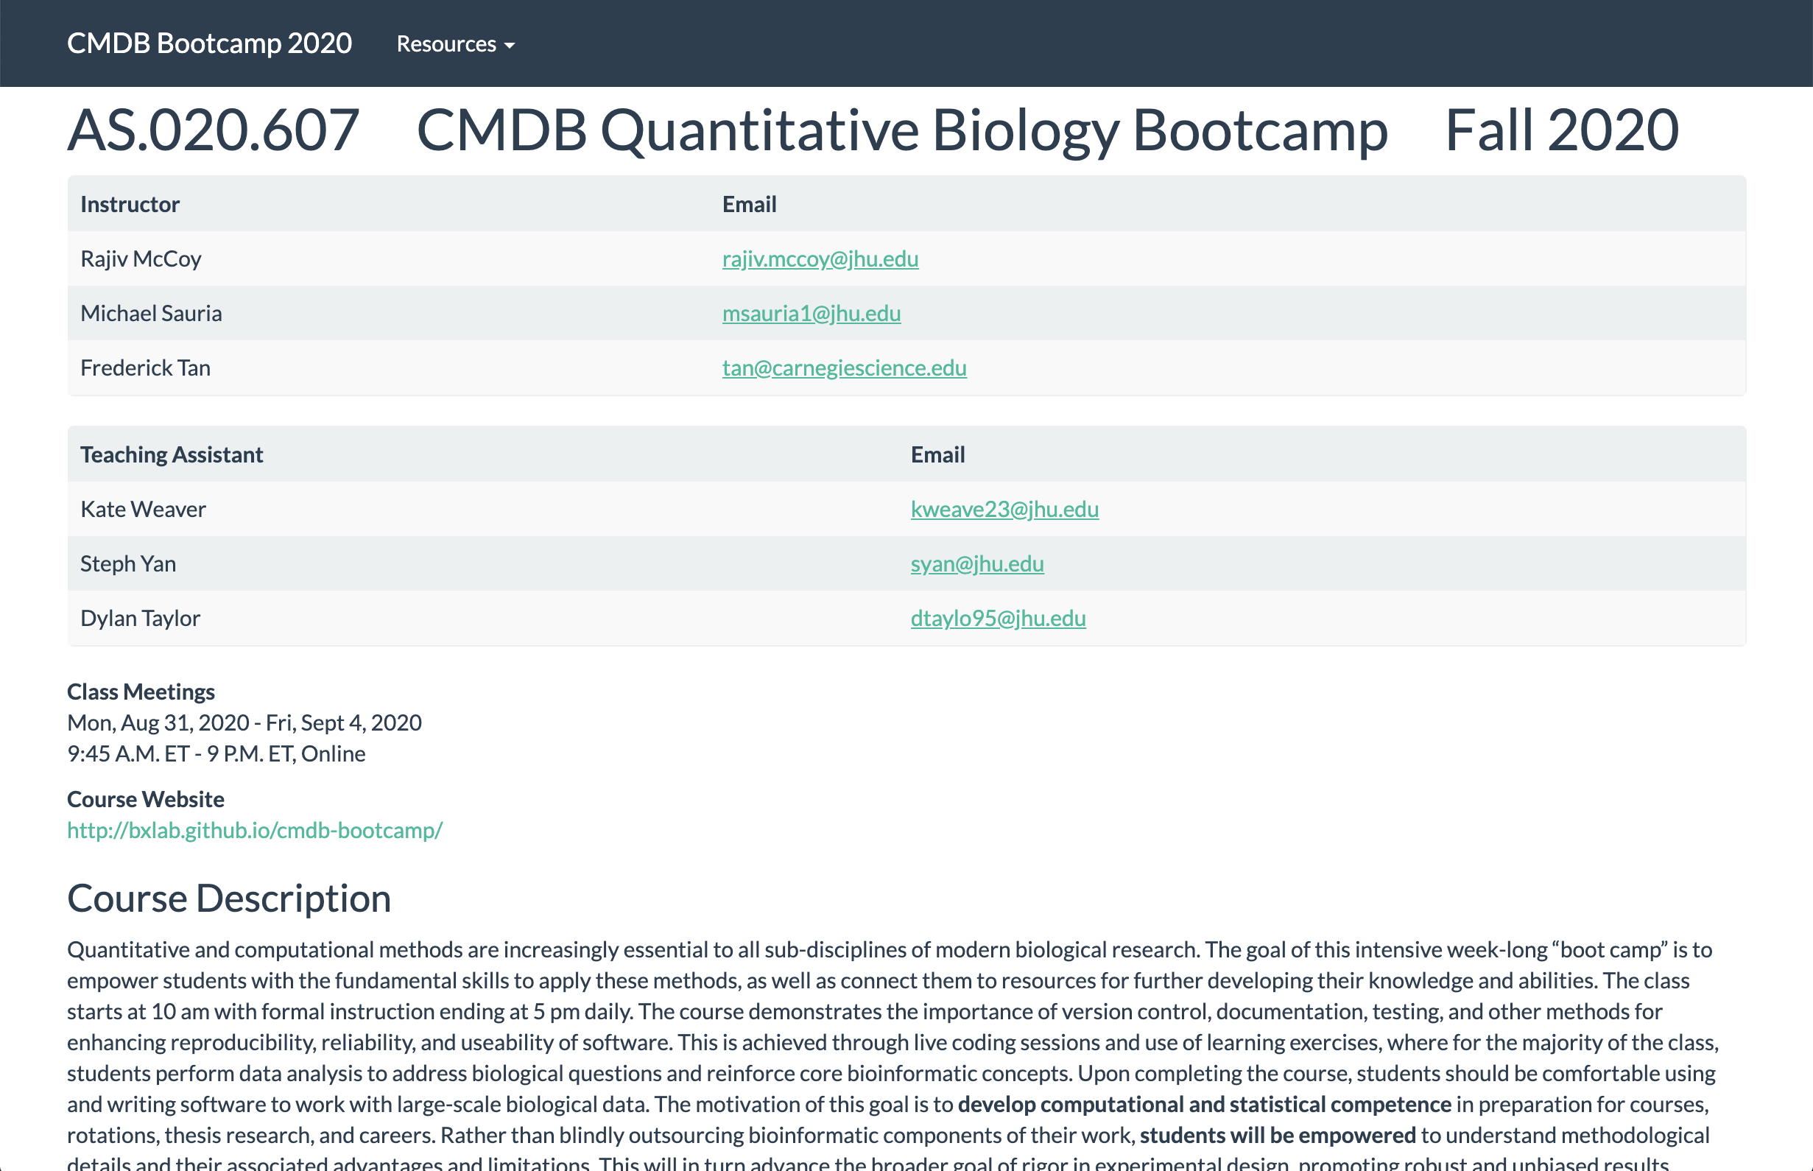
bxlab.github.io/cmdb-bootcamp/syllabus

Slide 27
Five Day Agenda
Mon
Tue
Wed
Thu
Fri
Python
Python
Unix / Python
Python
Python / Unix
Data Analysis / Python Basics
Data Structures / Python Ecosystem
Run Programs / Create Scripts
Algorithmic Thinking / Statistics
Statistics / Pipelines

Slide 28
Your 10am Wake Up Call
10:00 - 10:30 Presentations / Q&A
10:30 - 12:00 Lesson (video + live coding)
12:00 - 3:00 Lunch Exercise
3:00 - 3:30 Presentations / Q&A
3:30 - 5:00 Lesson (video + live coding)
Homework Exercise

Slide 29

Working Collaboratively
Work and present in teams
Submit individually to
qbb2020-answers
Some files distributed via qbb2020

Slide 30
Attendance
Due to the interactive nature of this course, there is a policy that students should not participate in any other meetings, courses, or lab work throughout the week. We recognize that this year is unique in that elective courses may begin concurrent with bootcamp. However, as a core CMDB course, bootcamp should take priority. If a student foresees attendance conflicts among their courses, they should contact a TA immediately so that this policy can be communicated to the necessary parties.
Please be on time for course activities, and budget extra time in anticipation of technical delays. Your attendance is expected during all synchronous sessions and your effort is also expected during asynchronous sessions. Exceptions have been specifically granted for students in distant time zones. Please let us know about any emergencies, family responsibilities, illness, etc. that may prevent attendance, and we will work to accommodate reasonable requests.

Slide 31



For Biologists with No Python/Unix Experience
Kate Weaver • Steph Yan • Dylan Taylor

Slide 32
Guidelines and Expectations
No question is too simple
No question has been asked too many times
Use Slack for sending messages
Keep your Zoom camera on when possible

Slide 33
Technology
Notes:
Section 1

Slide 34
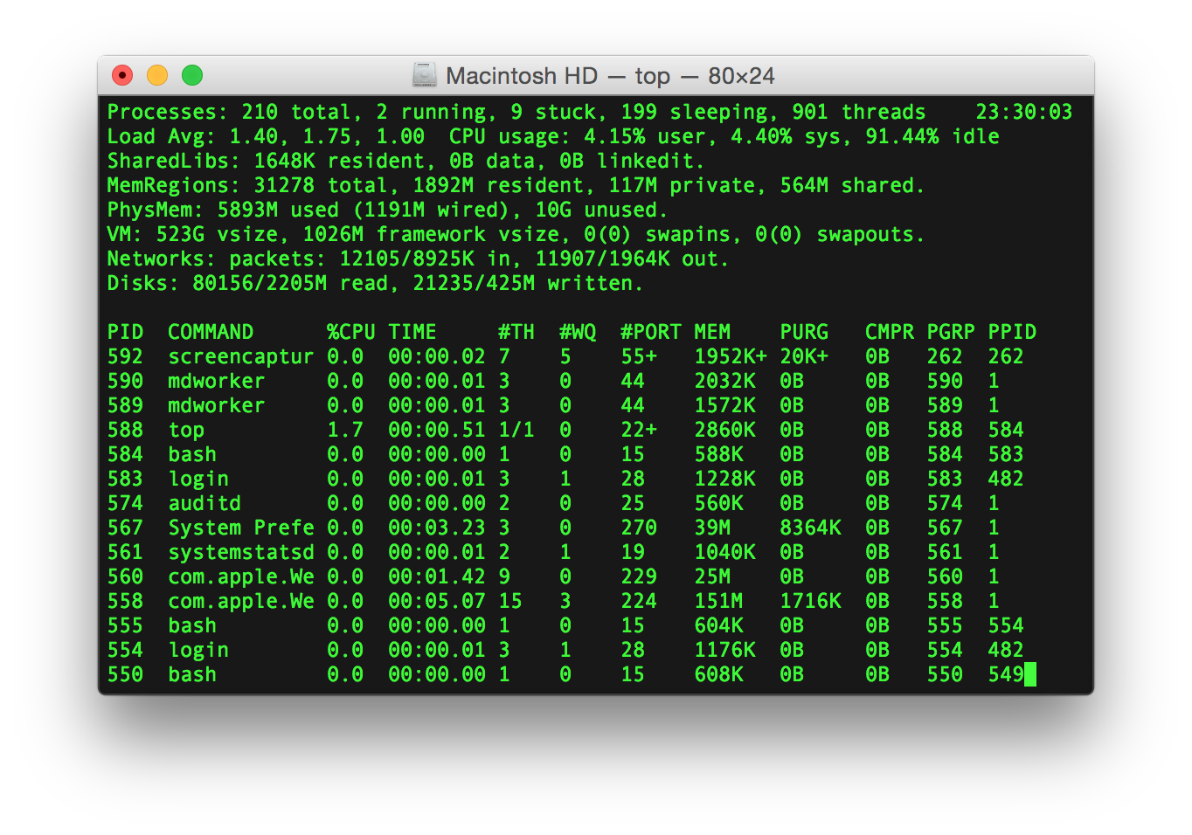
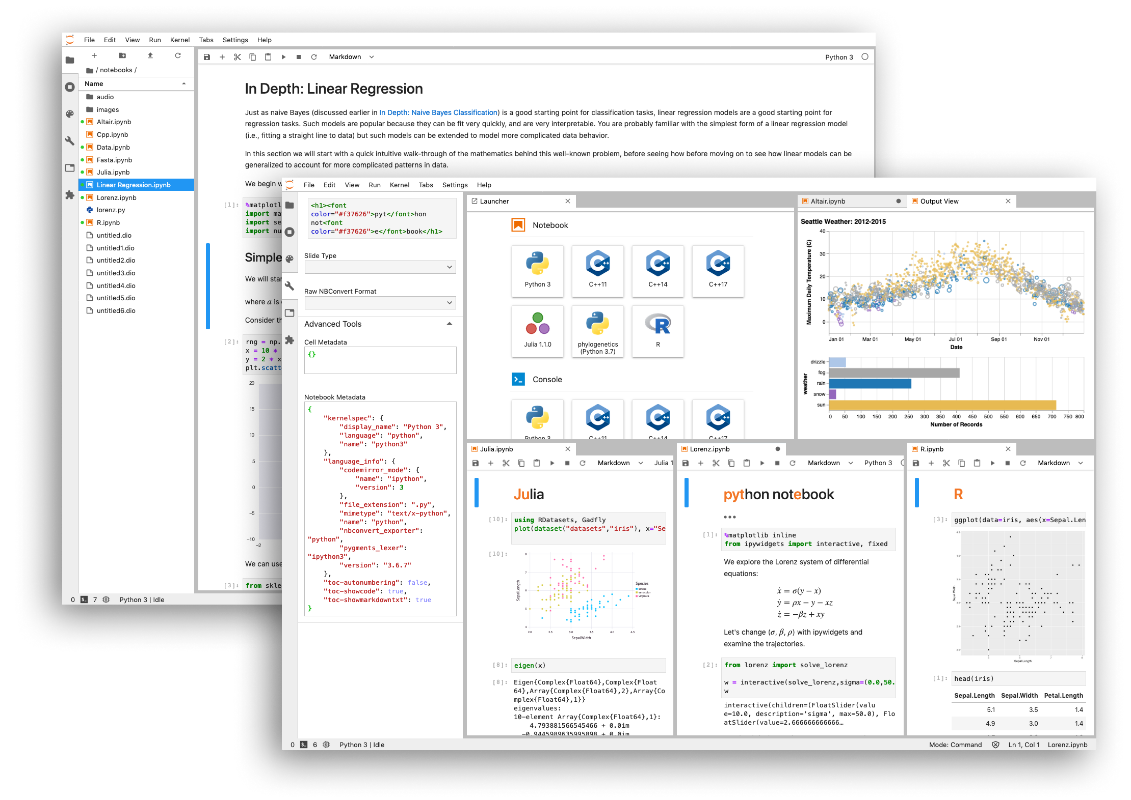
Computational Tools
Terminal
Jupyter

Slide 35



Communication Tools
Zoom
Slack
Poll Everywhere

Slide 36
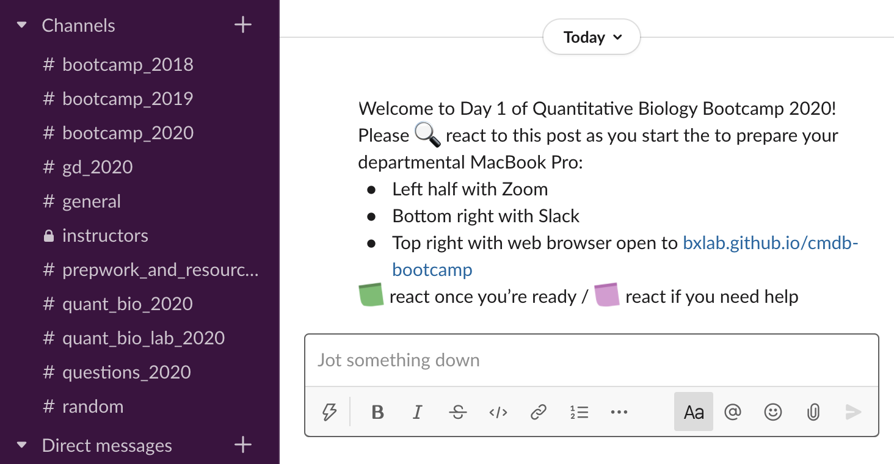

Slide 37
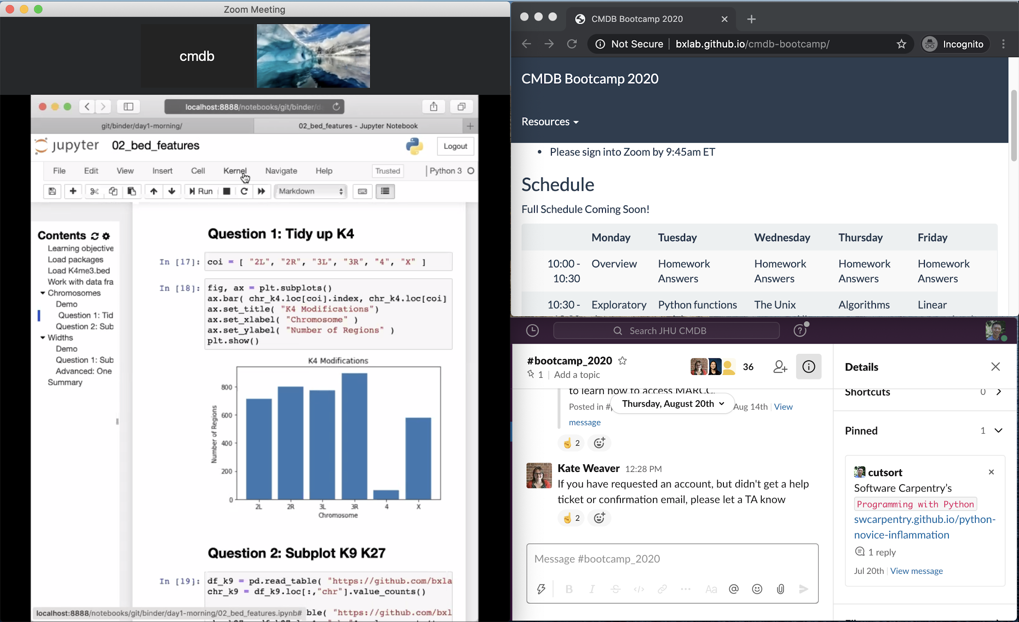


Managing Multiple Laptop Windows
Chrome

Slide 38
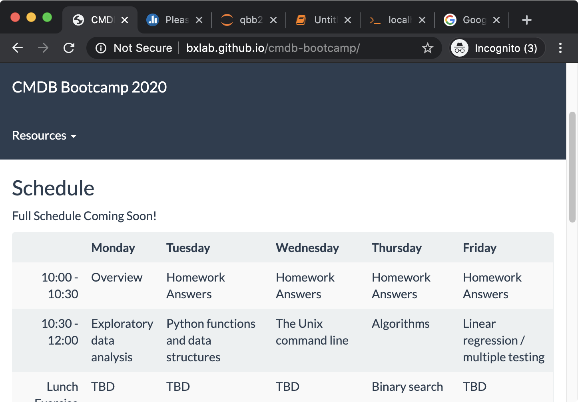
Managing Multiple Web Browser Tabs
Agenda
Jupyter
Terminal
Poll Everywhere
Notebook
Google

Slide 39
Directory Structure
/Users/cmdb/Applications
/Users/cmdb/Desktop
/Users/cmdb/Documents
/Users/cmdb/Downloads
/Users/cmdb/Library
/Users/cmdb/Movies
/Users/cmdb/Music
/Users/cmdb/Pictures
/Users/cmdb/Public
/Users/cmdb/bin
/Users/cmdb/data
/Users/cmdb/init
/Users/cmdb/miniconda
/Users/cmdb/qbb2020
/Users/cmdb/qbb2020-answers
../data/genomes
../data/rawdata
../data/results
../qbb2020-answers/README.md
../qbb2020-answers/day1-morning
../qbb2020-answers/day1-afternoon
../qbb2020-answers/day2-morning
../qbb2020-answers/day2-afternoon
../qbb2020/README.md
../qbb2020/binder
../qbb2020/data
../qbb2020/prep
../qbb2020/resources_for_prep

Slide 40
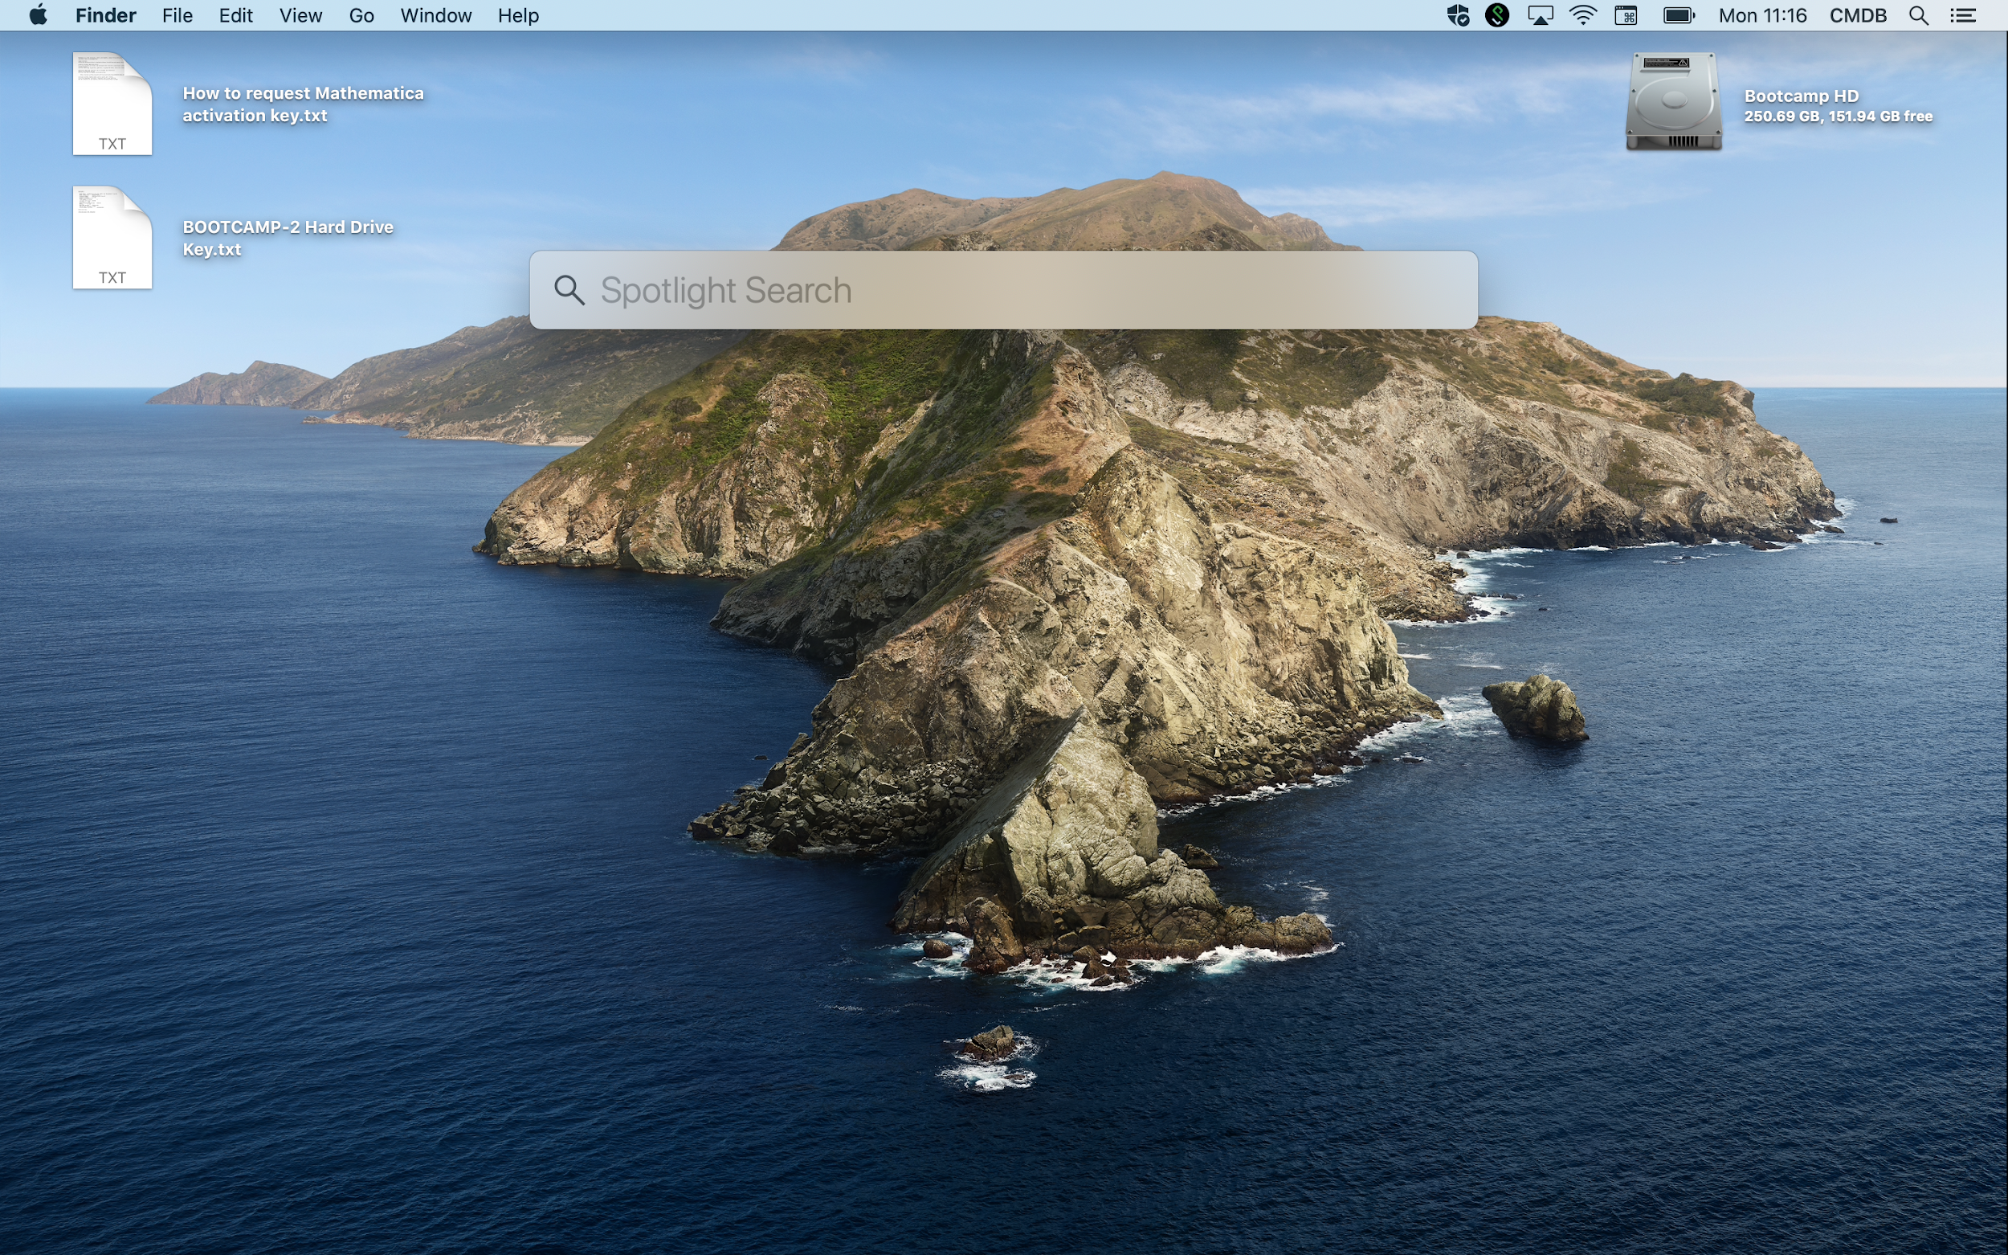

Slide 41
Contributions
James Taylor
Frederick Tan
Rajiv McCoy
Mike Sauria
Kate Weaver
Stephanie Yan
Dylan Taylor
Notes:
Thank you to all the people that helped!

